Slide 1
Warm up
A function is even. Point A(-3, 4) is on the even function. Name another point.
A function is even. Point B(9, 2) is on the even function. Name another point.
Reflect C(-5, -3) over the y-axis.
Reflect D(2, -4) over the x-axis.
Reflect E(-12, 4) over y = -x.

Slide 2
Rotations

Slide 3
Rotate 90° Clockwise about the Origin (Same as 270° Counterclockwise)
Change the sign of x and
switch the order.

Slide 4
Rotate 90° clockwise about the origin

Slide 5
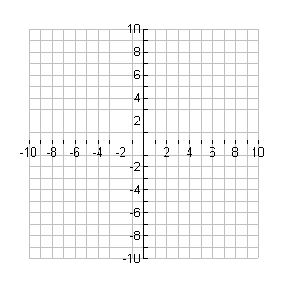
Rotate 90° clockwise about the origin
B
A
C

Slide 6
Rotate 90° Counterclockwise about the Origin (Same as 270° Clockwise)
Change the sign of y and
switch the order.

Slide 7
Rotate 90° counterclockwise about the origin

Slide 8
Rotate 90° counterclockwise about the origin
F
G
E

Slide 9
Rotate 180° about the Origin
ONLY change the signs!
(leave the order the same)

Slide 10
Rotate 180° about the origin

Slide 11
Rotate 180° about the origin
Q
T
R
S

