Slide 1
Warm up
Find the midpoint of points (2, -3) and (-14, 0)
Given the point (6, -5) is on the line perpendicular to y = 3x+7 , write the equation of the line.

Slide 2
Area

Slide 3
Area
Amount of space INSIDE the boundary

Slide 4
Area Formulas
Triangle: A = ½ bh
Rectangle: A = bh
Parallelogram: A = bh
Trapezoid: A = ½ (b₁ + b₂)h

Slide 5
Find the area. Q1 of 8
A = ½ bh

Slide 6
Find the area. Q2 of 8
A = bh

Slide 7
Find the area. Q3 of 8
A = ½ (b₁+b₂)h

Slide 8
Find the area. Q5 of 8
A = bh

Slide 9
Area on the Coordinate Plane

Slide 10
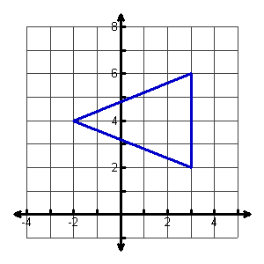
Find the area. Q6 of 8
A = ½ bh

Slide 11
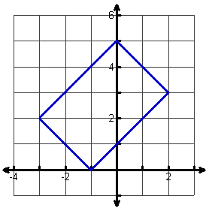
Find the area. Q7 of 8
A = bh

Slide 12
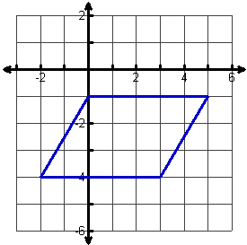
Find the area. Q8 of 8
A = bh

Slide 13
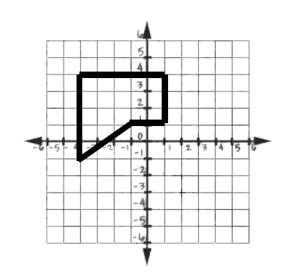
Find the area. Q8 of 8

Slide 14
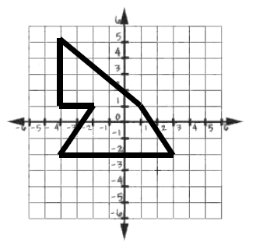
Find the area. Q8 of 8

