Slide 1
Warm up
Solve for y. Are any of the lines parallel or perpendicular?
2x + 3y = 5
4x – 2y = 8
x – ½ y = 6

Slide 2
Perimeter

Slide 3
Perimeter
Distance AROUND the shape

Slide 4
Find the perimeter. Q1 of 12

Slide 5
Find the perimeter. Q2 of 12

Slide 6
Find the perimeter. Q3 of 12

Slide 7
Find the perimeter. Q4 of 12

Slide 8
Perimeter on the Coordinate Plane

Slide 9
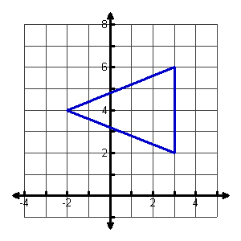
Find the perimeter. Q5 of 12

Slide 10
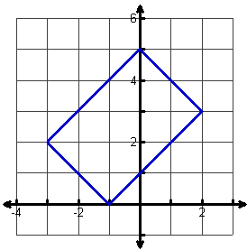
Find the perimeter. Q6 of 12

Slide 11
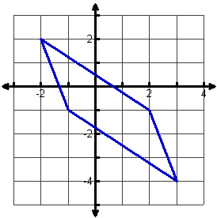
Find the perimeter. Q7 of 12

