Slide 1
Regression
Correlation vs. Causation

Slide 2
Correlation
Causation
A statistical way to measure the relationship between two sets of data.
Means that both things are observed at the same time.
Means that one thing will cause the other.

Slide 3
You can have correlation without causation
There is a correlation (relationship) between the number of firemen fighting a fire and the size of the fire.
(The more firefighters at the scene means that there is a bigger fire.)
However, this doesn’t mean that bringing more firemen will cause the size of the fire to increase

Slide 4
Is it Causation or Correlation?
Ex 1. A recent study showed that college students were more likely to vote than their peers who were not in school.
Correlation
Ex 2. Dr. Shaw noticed that there was more trash in the hallways after 2nd period than 1st period.
Correlation
Ex 3. You hit your little sister and she cries
Causation
Notes:
First two examples: correlations
Last example: causation

Slide 5
Measuring Correlation
Correlation is measured by the correlation coefficient, R.
R is a number between -1 and 1.
There are 4 traits to correlation:
    Form
    Direction
    Strength
    Outliers

Slide 6
FORM
Linear
Quadratic
No Correlation
Cubic
•
•
Exponential
•
•
•
•
•
•
•
•

Slide 7
Direction
Positive Correlation
Negative Correlation

Slide 8
Strength
Weak ---------------------------> Strong
R value (correlation coefficient)
0 ---------------------------> 1

Slide 9
Outliers
Data that doesn’t fit in

Slide 10
Put the correlation coefficients in order from weakest to strongest
Ex 1: 0.87, -0.81, 0.43, 0.07, -0.98
Ex 2: 0.32, -0.65, 0.63, -0.42, 0.04
0.07, 0.43, -0.81, 0.87, & -0.98
0.04, 0.32, -0.42, 0.63, & -0.65

Slide 11
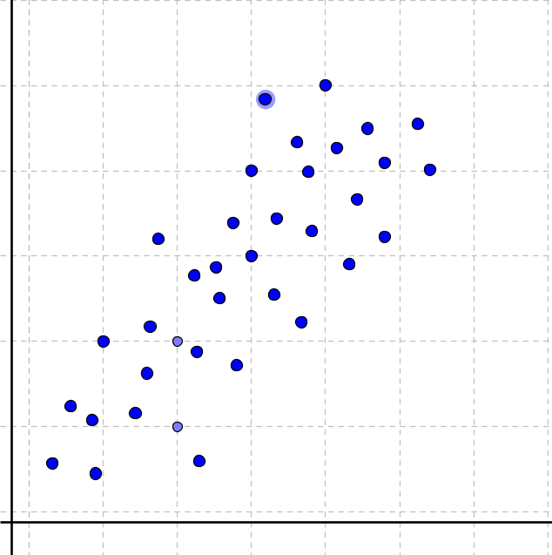
Match the Correlation Coefficient to the graph
Graph
Correlation Coefficients
-1
-0.5
0
0.5
1

Slide 12
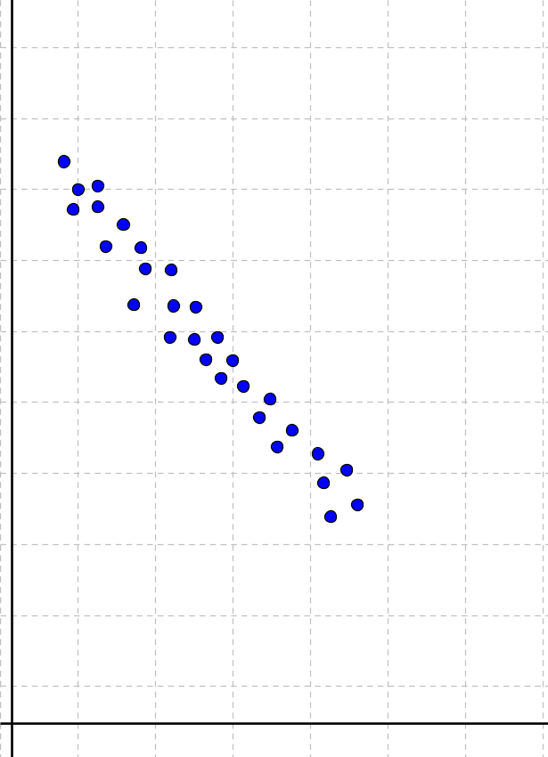
Match the Correlation Coefficient to the graph
Graph
Correlation Coefficients
-1
-0.5
0
0.5
1

Slide 13
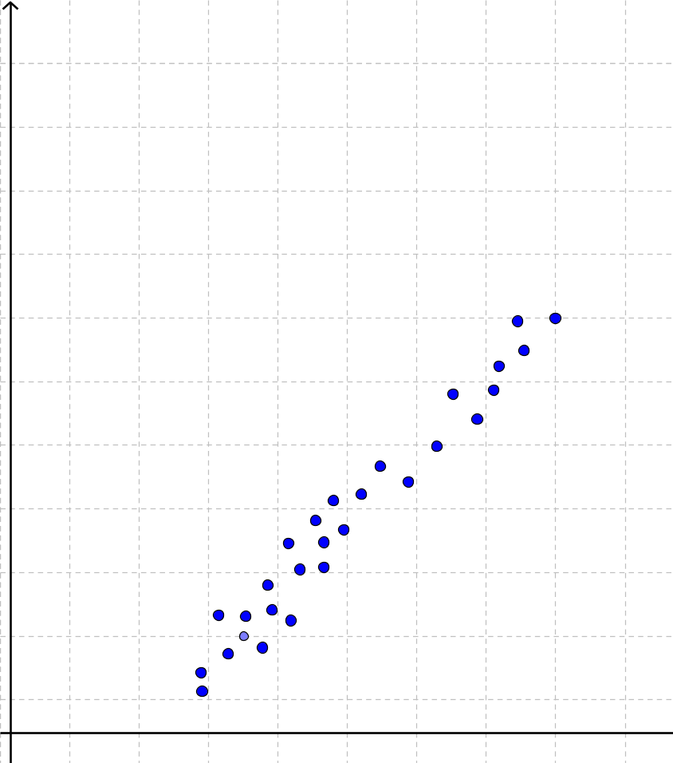
Match the Correlation Coefficient to the graph
Graph
Correlation Coefficients
-1
-0.5
0
0.5
1

Slide 14
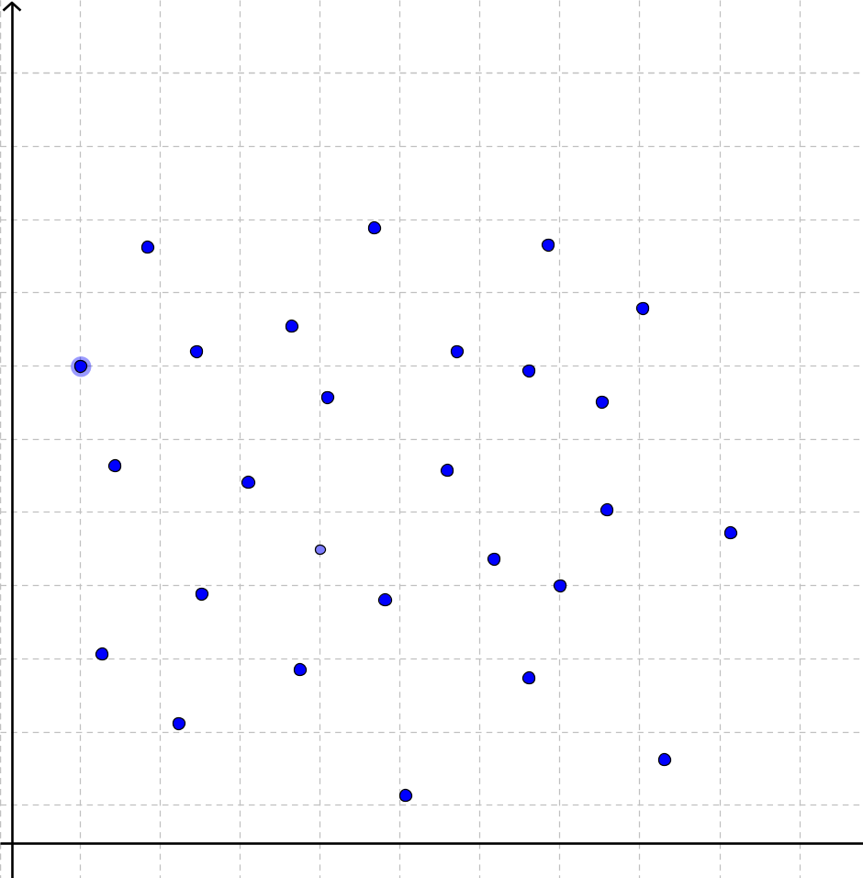
Match the Correlation Coefficient to the graph
Graph
Correlation Coefficients
-1
-0.5
0
0.5
1

Slide 15
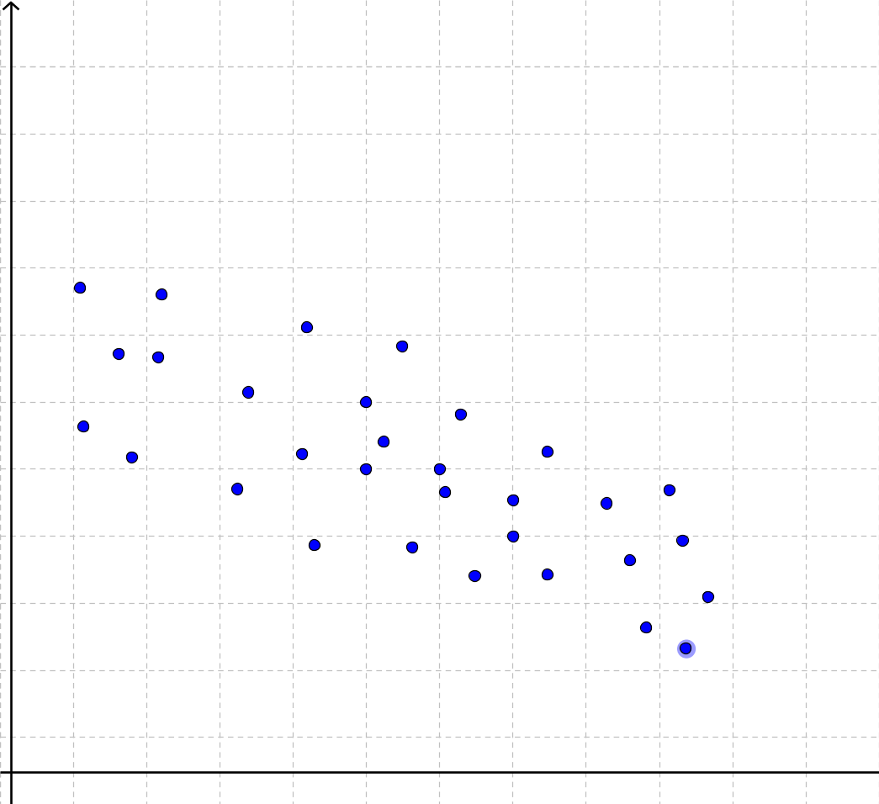
Match the Correlation Coefficient to the graph
Graph
Correlation Coefficients
-1
-0.5
0
0.5
1

Slide 16
Positive, Negative, or No Correlation?
The number of hours you work vs. The amount of money in your bank account
Positive
B. The number of hours workers receive safety training vs. The number of accidents on the job.
Negative
C. The number of students at Hillgrove vs. The number of dogs in Atlanta
No Correlation
Notes:
Draw a sketch of a graph to discuss….

Slide 17
Positive, Negative, or No Correlation?
D. The number of heaters sold vs. The months in order from February to July
Negative
E. The number of rice dishes eaten vs. The number of cars on I-75 throughout the day
No Correlation
F. The number of calories burned/lost vs. The amount of hours walked
Positive

Slide 18
Classwork
Correlation Worksheet (with notes)

Slide 19
Homework
Correlation & Causation Worksheet

